Slide 1
Neural Networks 1
Anders Krogh
Center for Health Data Science
University of Copenhagen

Slide 2
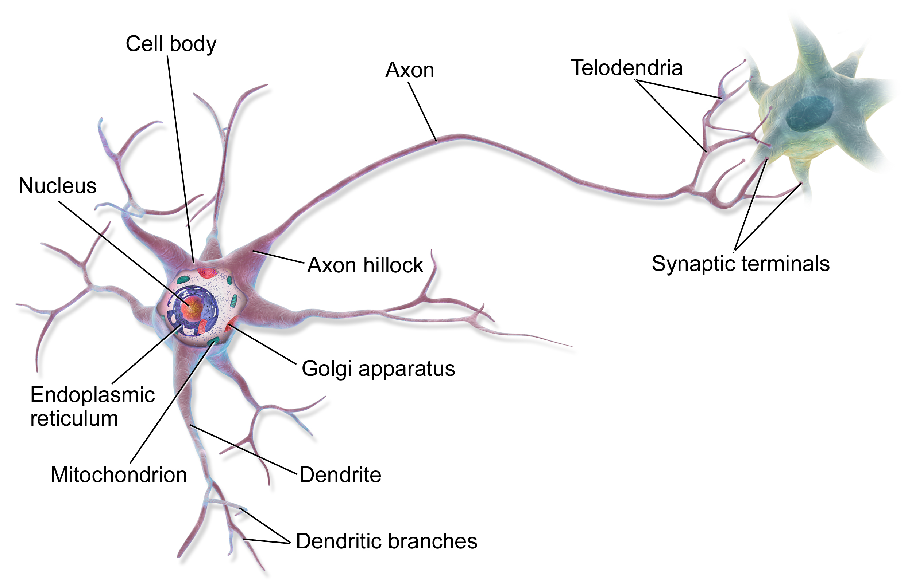
Inspiration from the brain
Brain computes by sending electric signals between neurons
Learning happens by modifying the strengths of the contacts – the synapses
Neuron
Illustration of neuron by BruceBlaus - Own work, CC BY 3.0, https://commons.wikimedia.org/w/index.php?curid=28761830

Slide 3
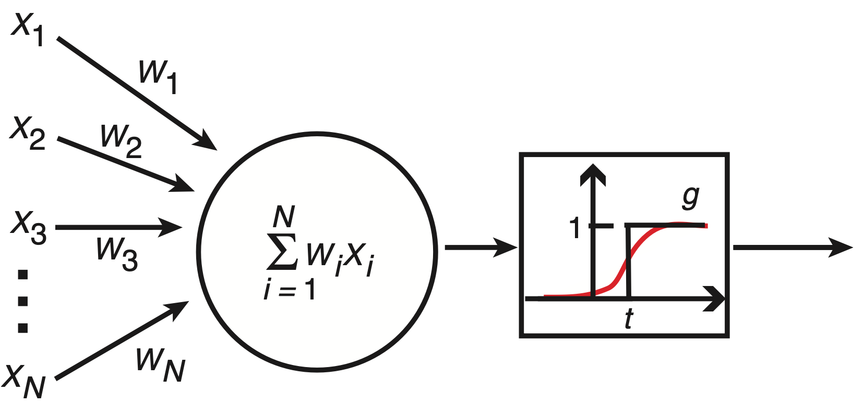
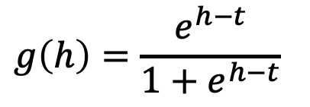
A mathematical model of the neuron
This is the basis for most artificial neural network models
McCulloch and Pitts proposed this model in 1943
Weighted sum
Activation function
Sigmoid activation function (red curve)
Input form other neurons
Output
$$g\left(h\right)=\frac{e^{h−t}}{1+e^{h−t}}$$
Threshold: t
Figure from A Krogh,: What are artificial neural networks?, Nat. Biotech. 26, p. 195-197, 2008

Slide 4
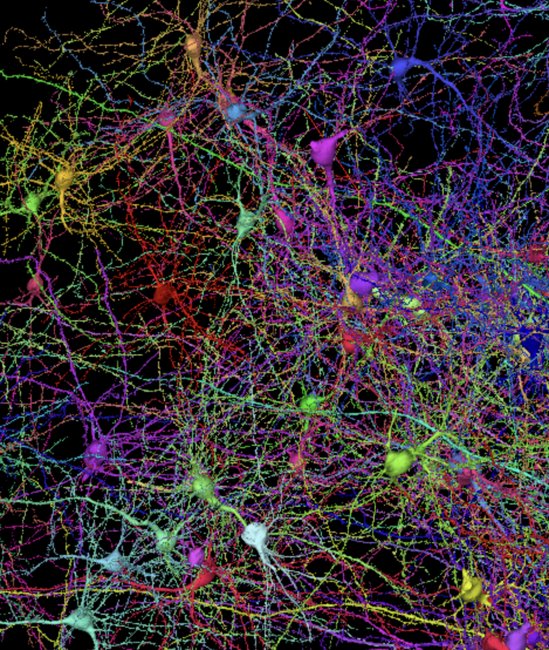
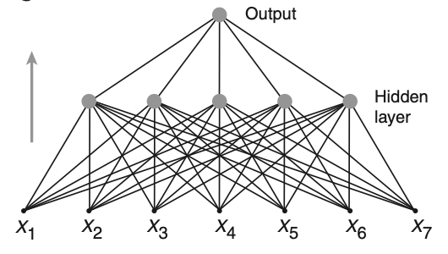
Many connected neurons ➜ neural network
Artificial neural network
Feed-forward NN
Screenshot from https://h01-release.storage.googleapis.com/gallery.html
Figure from A Krogh,: What are artificial neural networks?, Nat. Biotech. 26, p. 195-197, 2008

Slide 5

Learning from examples
Humans learn from examples
By seing enough pictures of cats, a child can learn to recognize a cat
Artificial neural networks also learn from examples
Google search for ”cat pictures”

Slide 6

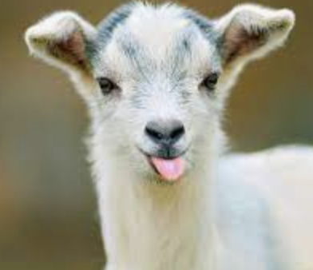
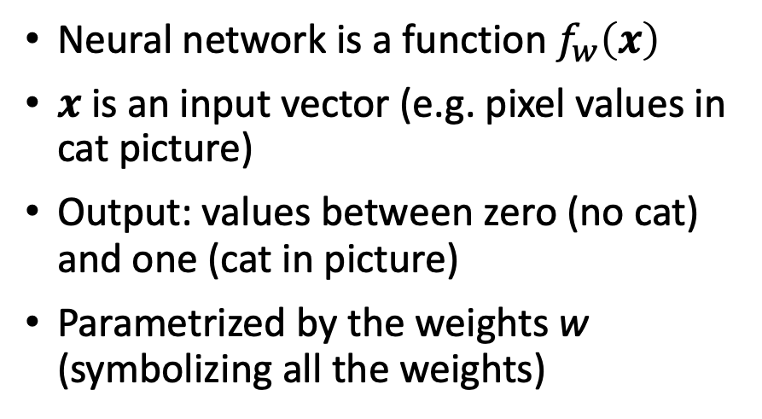
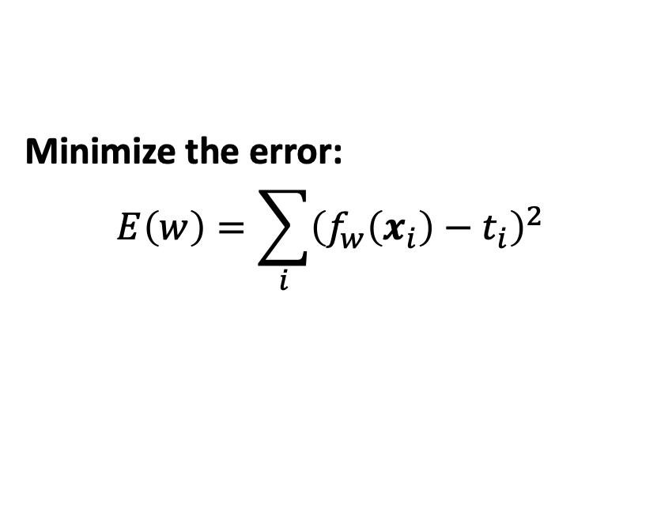
Learning by minimizing the error
Neural network is a function $f_{w}\left(x\right)$
$x$ is an input vector (e.g. pixel values in cat picture)
Output: values between zero (no cat) and one (cat in picture)
Parametrized by the weights w (symbolizing all the weights)
Train on a set of labeled examples called the training set.
Labels:
t=1 (cat)
t=0 (not cat)
Learning: Find the weights that give the desired output as close as possible
Minimize the error:
$$E\left(w\right)=\sum_{i}{{\left(f_{w}\left(x_{i}\right)−t_{i}\right)}^{2} }$$
Glossary:
Error is often called loss or cost
Labels are also called targets
Sum is over training examples

Slide 7
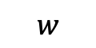
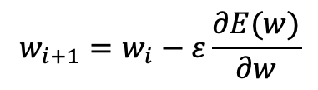

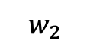
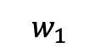
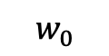
Minimize the error by gradient descent
Gradient descent is a general method for function minimization
It is an iterative procedure: take a small step in the direction opposite to the gradient in each iteration
The gradient:
The partial derivative for each weight in the network
A vector that points in the direction of fastest growth of the function
One-dimensional example
Take small steps opposite the gradient
$$E\left(w\right)$$
$$w_{i+1}=w_{i}−ε\frac{∂E(w)}{∂w}$$
$$w_{1}$$
$$w_{0}$$
$$w_{2}$$
$$w$$
Gradient descent leads to the famous Back-propagation algorithm for neural networks
Fortunately we do not have to derive the math – modern neural network programs automatically calculate the gradients

Slide 8
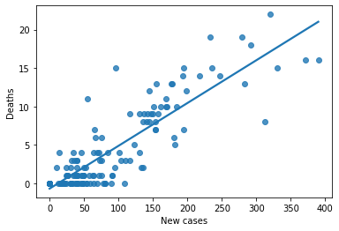
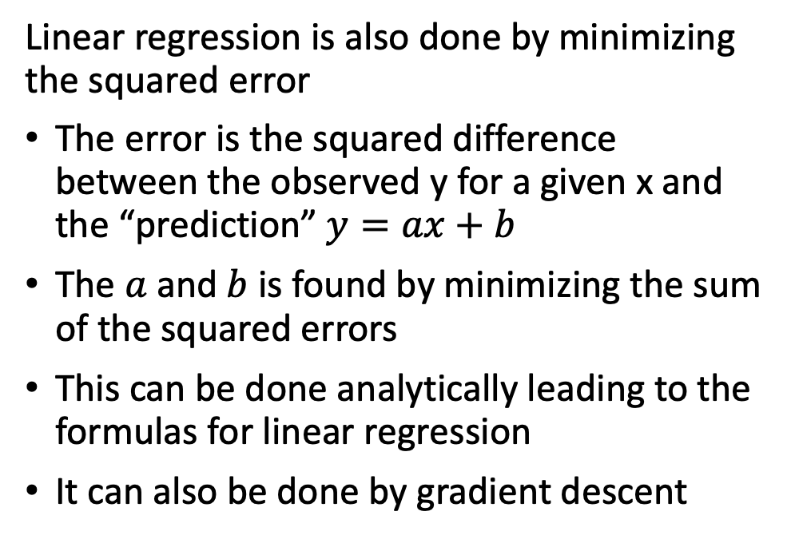
Analogy to linear regression
Points show the number of deaths vs new Corona cases in Denmark per day from March to July 2020
Linear regression is also done by minimizing the squared error
The error is the squared difference between the observed y for a given x and the “prediction” $y=ax+b$
The $a$and $b$is found by minimizing the sum of the squared errors
This can be done analytically leading to the formulas for linear regression
It can also be done by gradient descent
Regression line
There are many examples/animations of this online, e.g.:
https://towardsdatascience.com/gradient-descent-animation-1-simple-linear-regression-e49315b24672

Slide 9
Python example
In this example, the gradient is calculated manually
We do not have to do that again – pytorch will take care of it
Copy this Colab notebook:
https://drive.google.com/file/d/1Oqmad5JpPI2rzrWDrMiGPs3QinyxT8sO/view?usp=sharing

Slide 10
More realistic networks
The regression example has two “weights” a and b
Normally the neural networks have thousands of weights and thresholds (some even millions)
In the examples there were a single output unit
Sometimes we have several output units
We often discriminate between networks for
Classification with binary targets (like cat/no cat)
Regression with continuous target values (like linear regression)
Learning follows the same principles, but the error function may change

Slide 11
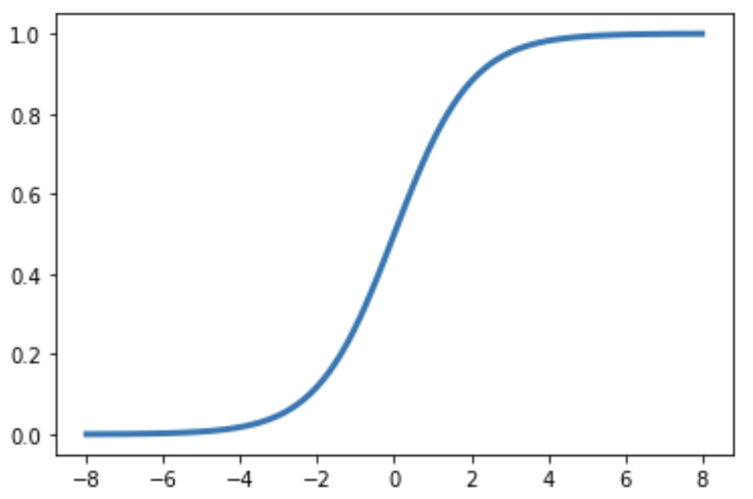
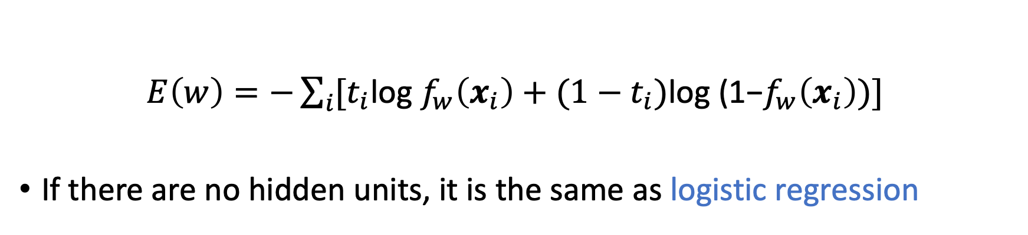
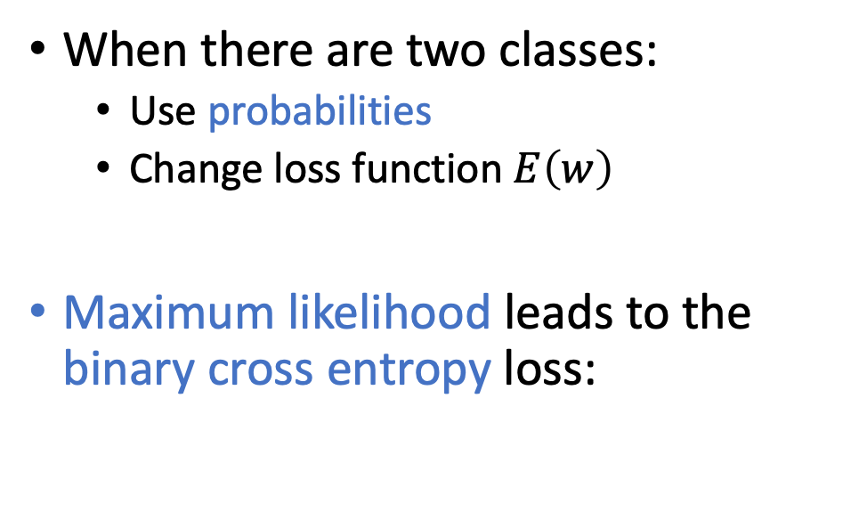
Classification
P(cat)=1
When there are two classes:
Use probabilities
Change loss function $E\left(w\right)$
Maximum likelihood leads to the binary cross entropy loss:
Sigmoid output
P(cat)=0
$E\left(w\right)=−\sum_{i}{{[t}_{i}\text{log} f_{w}\left(x_{i}\right)+}$ ${(1−t}_{i})\text{log}\text{ (1−}f_{w}\left(x_{i}\right))]$
If there are no hidden units, it is the same as logistic regression

Slide 12
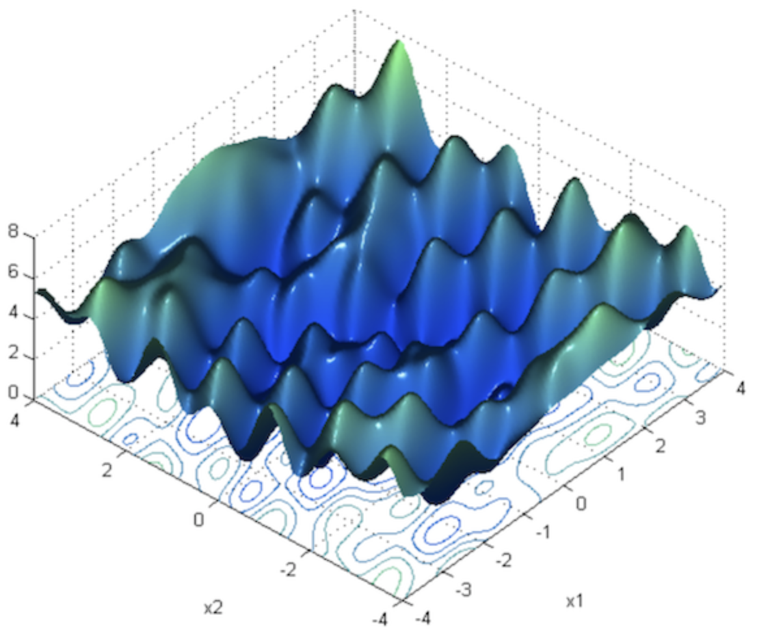
Stochastic gradient descent
For complex networks the loss has multiple local minima
Plain gradient descent does not work well
Stochastic gradient descent use “mini batches”
The gradient is calculated over a random sample of a certain size – the batch size
For each cycle through the training set (epoch), the network is updated many times instead of just one
Because of the randomness it can better escape local minima and has turned out to be much more efficient
There are many other “tricks”. Many of these are combined in the popular optimizer called Adam
Figure copied from: https://towardsdatascience.com/neural-network-optimization-7ca72d4db3e0

Slide 13

pytorch.org
Pytorch is a Python package for neural networks
It makes it easy to design and train neural networks, because of
Automated differentiation to calculate gradients
Efficient use of hardware (including GPUs)
It uses tensors, which are multidimensional numerical arrays with many convenient mathematical operations (as in linear algebra)
To start with pytorch, you need not worry about tensors
LET US TRY!

